Slide 1

Service Mesh

Slide 2

I own an app
Book info
Reviews
Service
Product Page
Service
Details
Service

Slide 3

I’m cool.

Slide 4

So I’m using Kubernetes

Slide 5
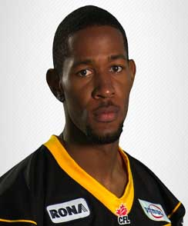
But then, the boss comes over and says…
A client has been “tipping over” our servers.
What do we do?
- Boss

Slide 6

Anonymous client.
Sent 10,000 requests to productpage…
…
…
…
over the course of an hour and brought all our systems down.

Slide 7

How do we make sure this never happens again?

Slide 8
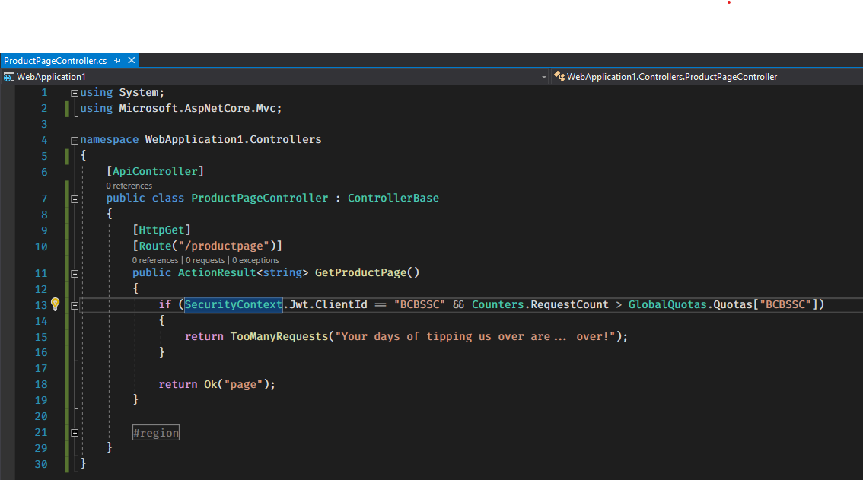
So I start coding.

Slide 9
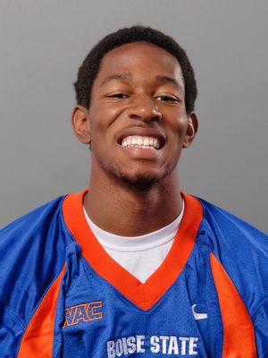
Boss’ happy again.
Yay!
- Boss

Slide 10
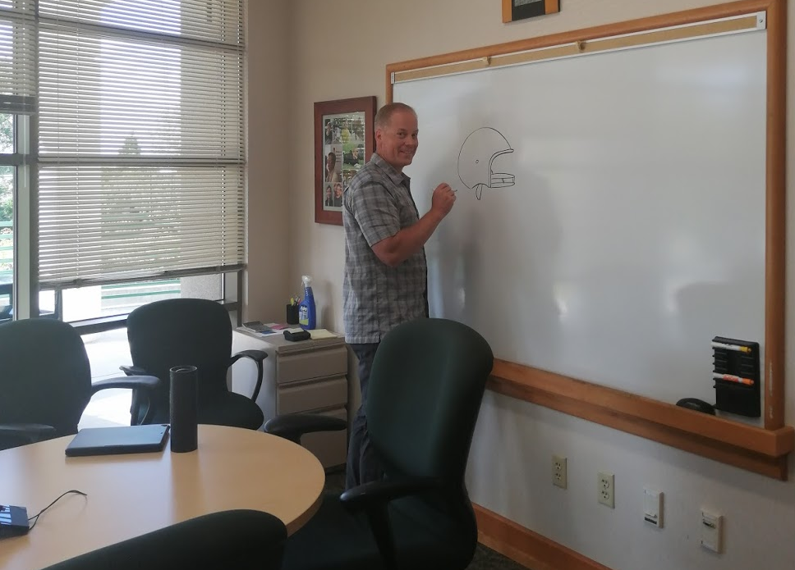
Back to solving the hard problems!
Sweet!
- Boss’ boss

Slide 11
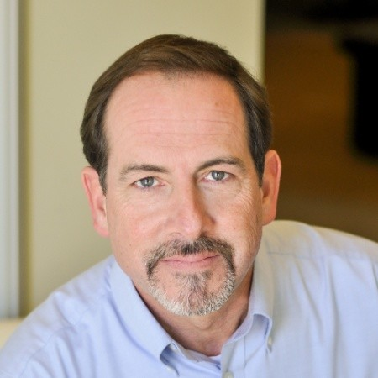
But then… change!
How do we extend this to other clients?
How do we apply the same rules to other services?
-VP.

Slide 12
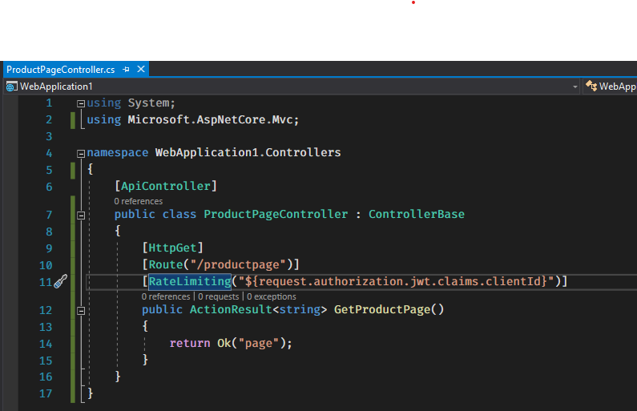
Sometime later…

Slide 13
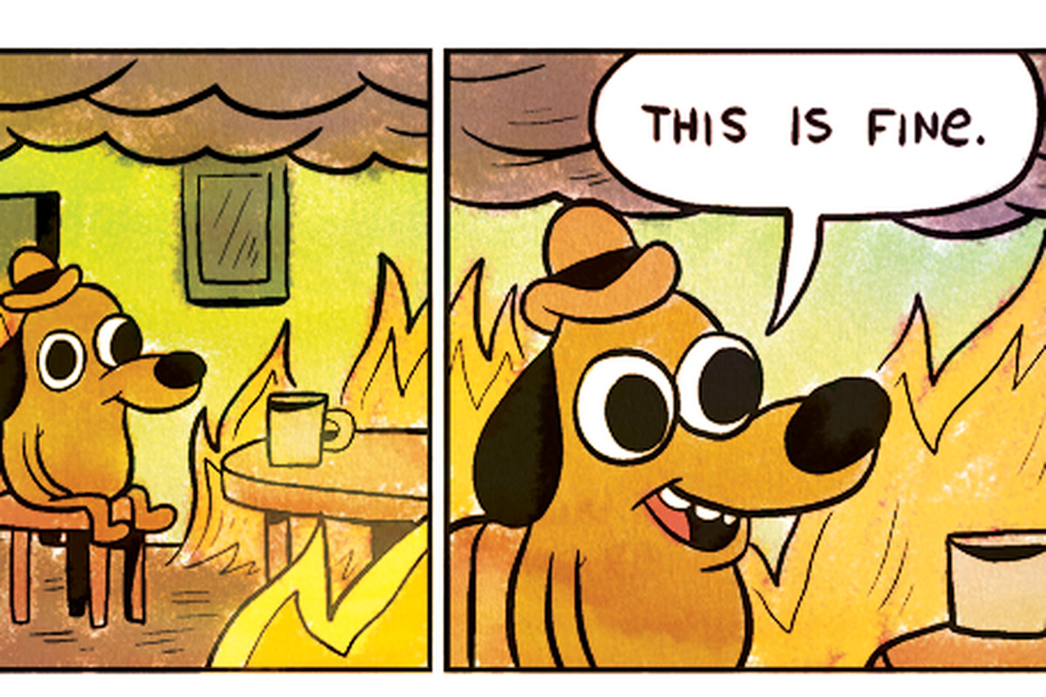
Make it flexible!
What if we need quotas per service?
What if we want to add dimensions to the quota calculation?
What if we want to enable exceptions?

Slide 14

Let someone else take care of it.
Book info
Reviews
Service
Product Page
Service
Sidecar proxy
Details
Service
Sidecar proxy
Sidecar proxy

Slide 15

Enforce the rules before they reach the app
Book info
apiVersion: config.istio.io/v1alpha2
kind: instance
metadata:
name: requestcountquota
namespace: istio-system
spec:
compiledTemplate: quota
params:
dimensions:
source: request.headers["x-forwarded-for"] | "unknown"
destination: destination.labels["app"] | destination.workload.name | "unknown"
---
apiVersion: config.istio.io/v1alpha2
kind: handler
metadata:
name: memquotahandler
namespace: istio-system
spec:
compiledAdapter: memquota
params:
quotas:
- name: requestcountquota.instance.istio-system
maxAmount: 120
validDuration: 1s
Product Page
Service
HTTP 429: (TooManyRequests) Sorry, bruh,
Had it coming.
Sidecar proxy

Slide 16
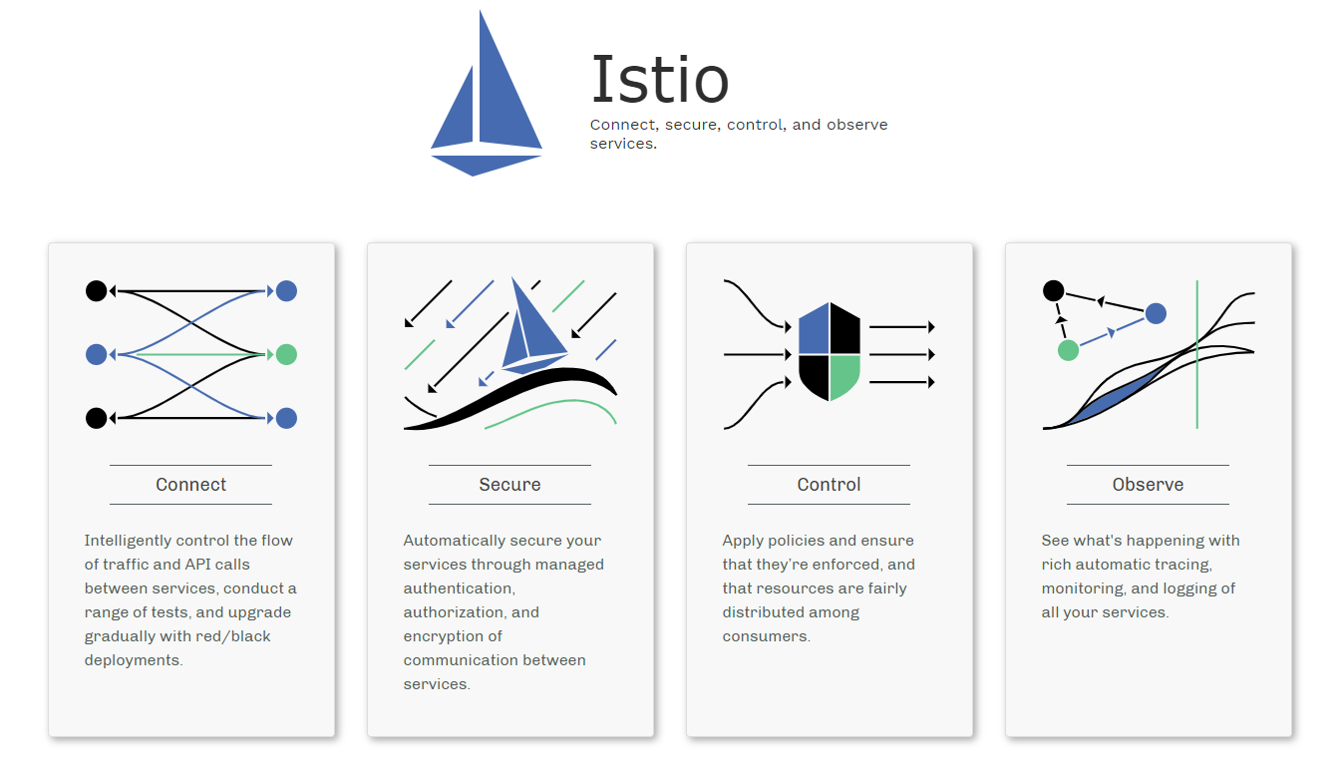

Slide 17

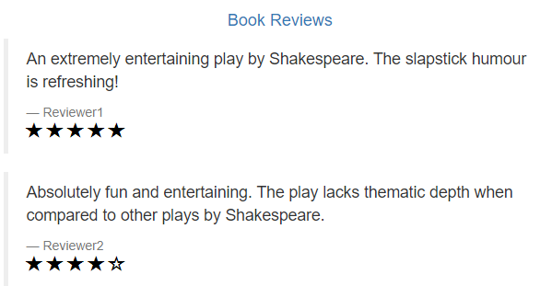
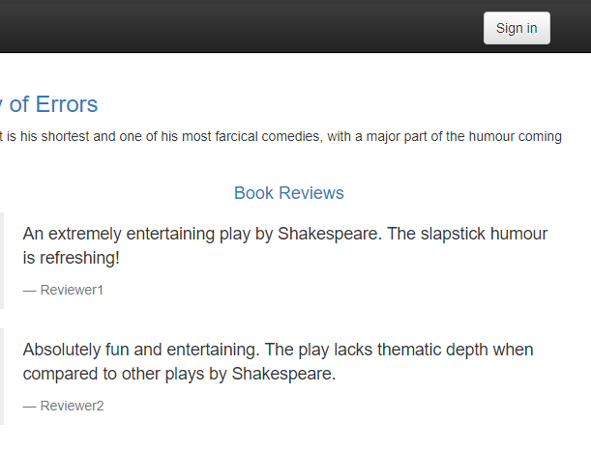

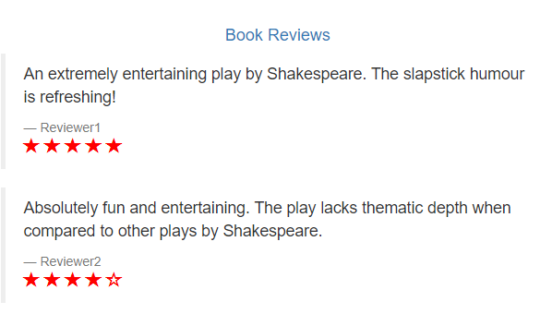
How to evolve my app?
V2 (★)
V1 ( ? )
V3 (★)

Slide 18
Service Mesh @ Healthwise
Rate Limiting.
A/B Testing.
Canary Deployments.
Fault injection.

Slide 19

Come on!

Slide 20

In Memoriam

